Slide 1
CS 4974 Independent Study
11/7/22 meeting
Student: Bug Lee

Slide 2
Last time, we discussed…
Build parser that produce Abstract Syntax Tree
Suggestion on how to use Visitor design pattern for semantic analysis and code generation

Slide 3
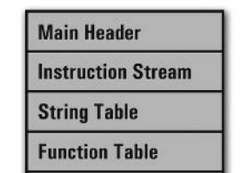
Week 10
(Goal is to implement working compiler by week 11)
compiler
assembler
script.source
script.assembly
script.executable
Virtual Machine
CPU

Slide 4
Extending grammar
program → declaration* EOF ;
declaration → varDecl
| statement ;
varDecl → "var" IDENTIFIER ( "=" expression )? ";" ;
statement → exprStmt
| printStmt
| block ;
exprStmt → expression ";" ;
printStmt → "print" expression ";" ;
block → "{" declaration* "}" ;

Slide 5
Extending grammar
expression → assignment ;
assignment → IDENTIFIER "=" assignment | equality ;
equality → comparison ( ( "!=" | "==" ) comparison )* ;
comparison → term ( ( ">" | ">=" | "<" | "<=" ) term )* ;
term → factor ( ( "-" | "+" ) factor )* ;
factor → unary ( ( "/" | "*" ) unary )* ;
unary → ( "!" | "-" ) unary | primary ;
primary → NUMBER | STRING | "(" expression ")" | IDENTIFIER ;

Slide 6
Semantic analyzer

Slide 7
Lexical (static) scoping using nested symbol table
Symbol | Size
x | 1
y | 1
Current scope
var x = 42;
var y;
{
var x = 999;
var local;
y = 0;
}
var x = 999;
var local;
y = 0;

Slide 8
Lexical (static) scoping using nested symbol table
Symbol | Size
x | 1
y | 1
var x = 42;
var y;
{
var x = 999;
var local;
y = 0;
}
var x = 999;
var local;
y = 0;
Symbol | Size
x | 1
local | 1
Current scope

Slide 9
Lexical (static) scoping using nested symbol table
Symbol | Size
x | 1
y | 1
Current scope
var x = 42;
var y;
{
var x = 999;
var local;
y = 0;
}
var x = 999;
var local;
y = 0;

Slide 10
Code Emitter

Slide 11
Compiling for stack machine vs register machine
Current implementation: stack machine
Emit assembly code that use VM stack for storing intermediate values

Slide 12
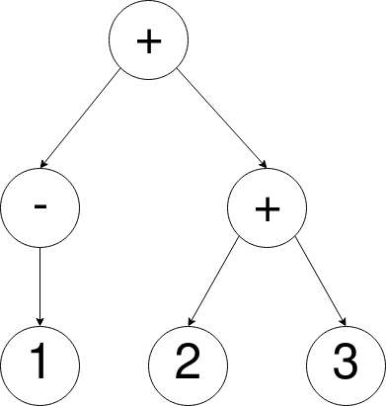
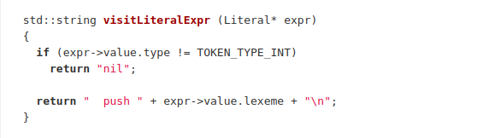
Post order traversal

Slide 13
Post order traversal

Slide 14
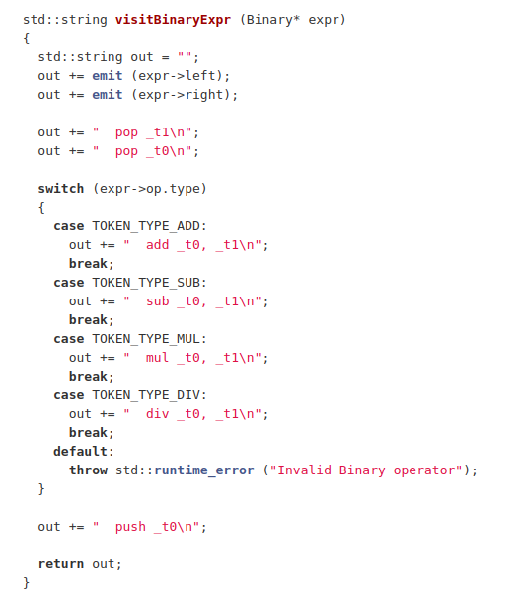
Post order traversal

Slide 15
Demo

Slide 16
Plan for week 11
Continue Compiler parser, semantic analyzer, and code emitter implementation.
Support Control Flow
Support Function call
Write programs in custom language!

